Slide 1
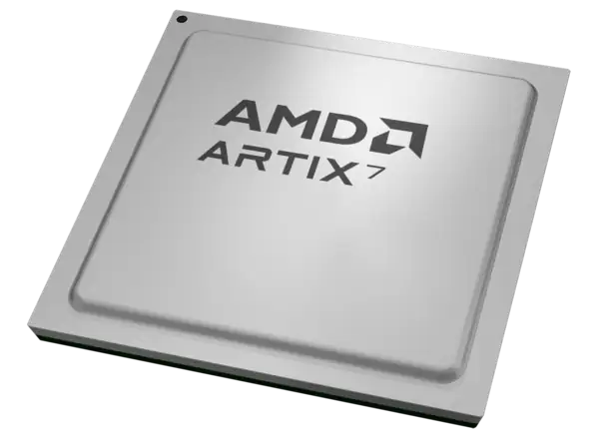
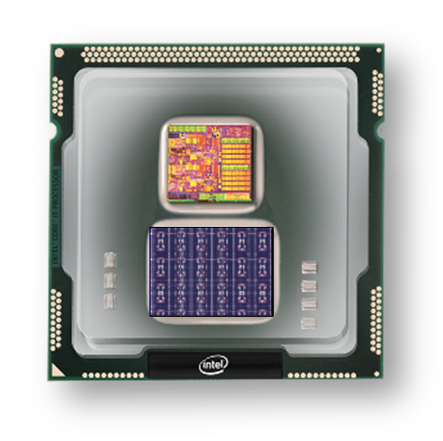
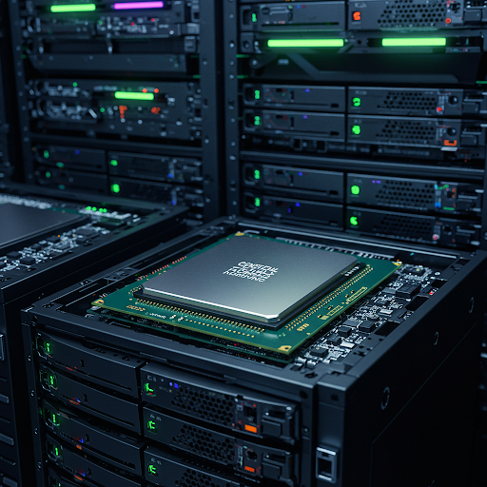
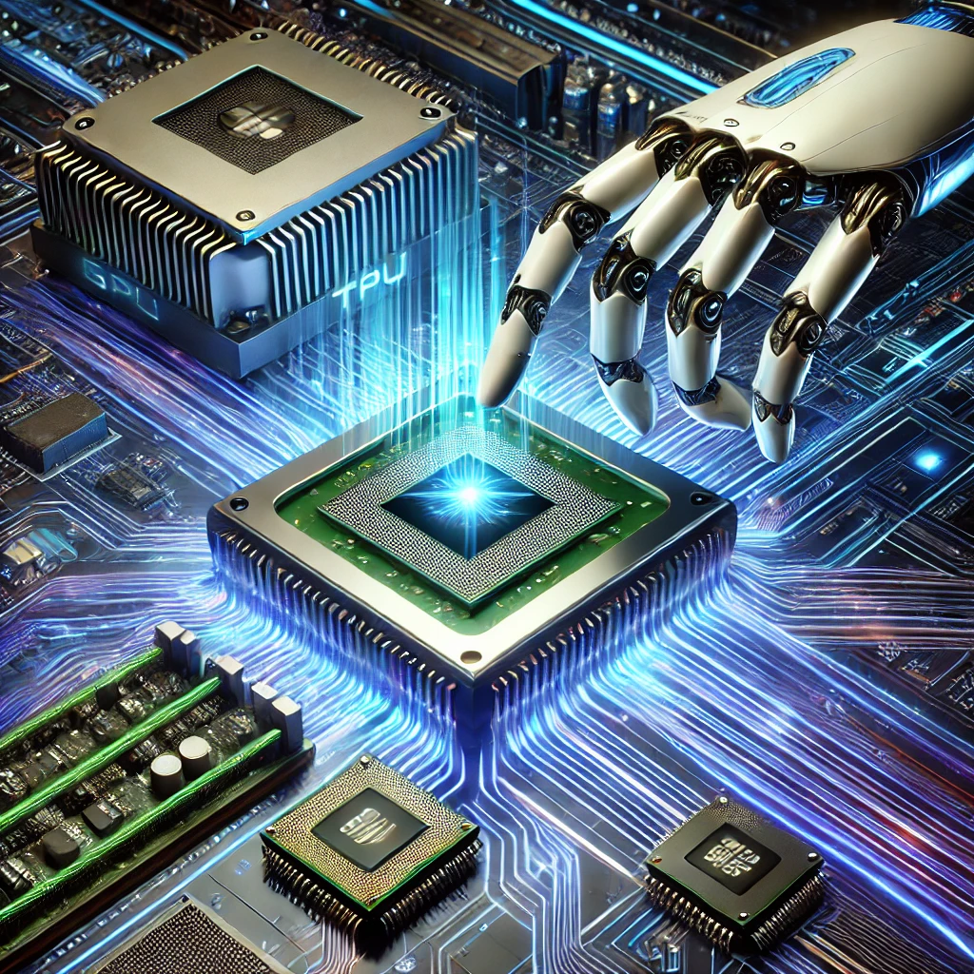
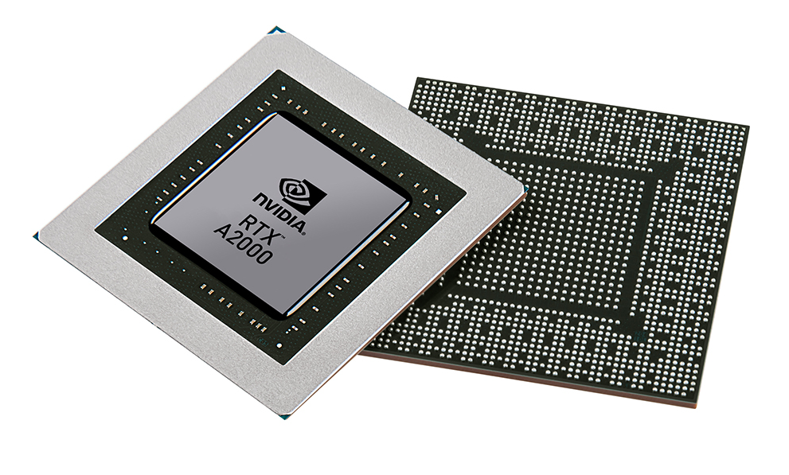


Christof Teuscher
ECE 410/510: Hardware for AI and ML
TPU + CNN/DNN + Transformers
Portland State University
Department of Electrical and Computer Engineering (ECE)
www.teuscher-lab.com
teuscher@pdx.edu

Slide 2
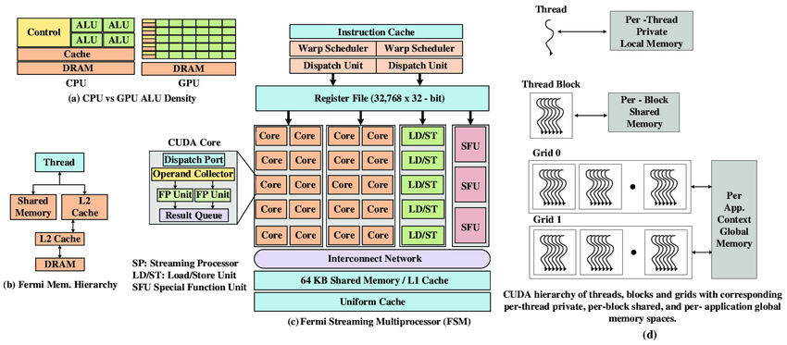
NVIDIA Fermi Microarchitecture
10.1109/ACCESS.2020.3008250

Slide 3
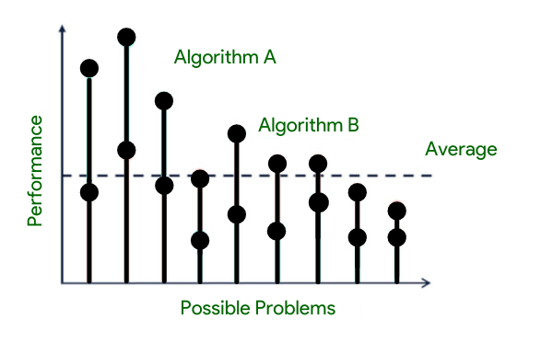
No Free Lunch theorem (NFL)
The "No Free Lunch" (NFL) theorem in optimization and machine learning states that, when averaged across all possible problems, all optimization algorithms perform equally well. I.e., no algorithm consistently outperforms random search or any other algorithm.
The NFL theorem was formalized by David Wolpert and William Macready in 1997.
This principle has profound implications for ML and HW optimization:
It explains why specialized algorithms/architectures work well for specific domains but fail in others.
It highlights the importance of incorporating domain knowledge when selecting algorithms/architectures.
It reminds us that claims about algorithm/architecture superiority must specify the context/problem class.
https://www.geeksforgeeks.org/what-is-no-free-lunch-theorem
https://ieeexplore.ieee.org/document/585893

Slide 4
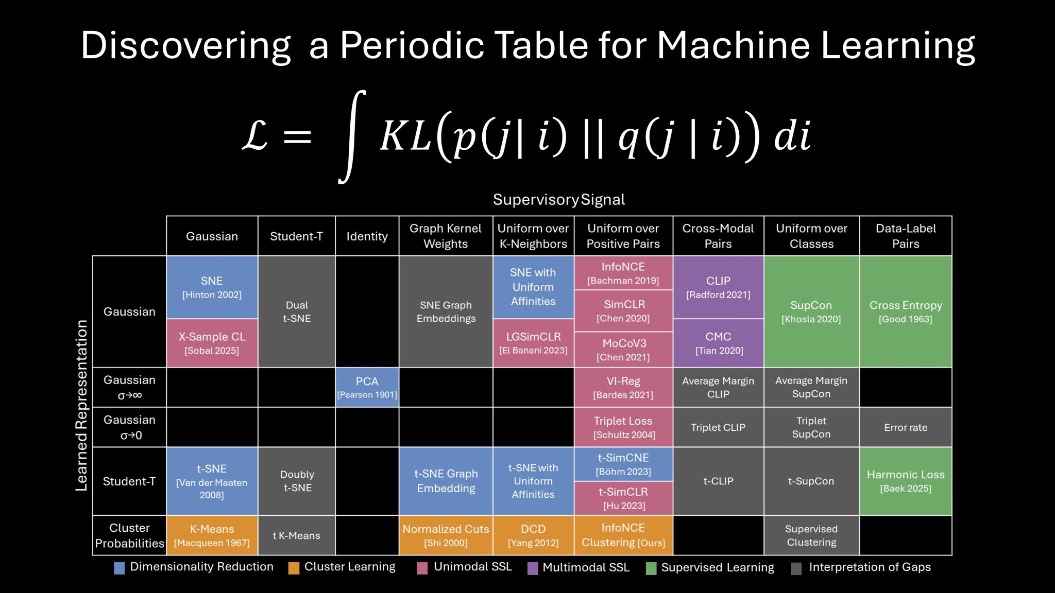
No Free Lunch theorem (NFL)
“All these algorithms learn a specific kind of relationship between data points. While each algorithm may accomplish that in a slightly different way, the core mathematics behind each approach is the same.”
Kullback-Leibler (KL) divergence, also known as relative entropy, measures the difference between two probability distributions. It quantifies how much information is lost if one distribution is used to approximate another
Generalized loss function
for all algorithms
https://openreview.net/forum?id=WfaQrKCr4X

Slide 5
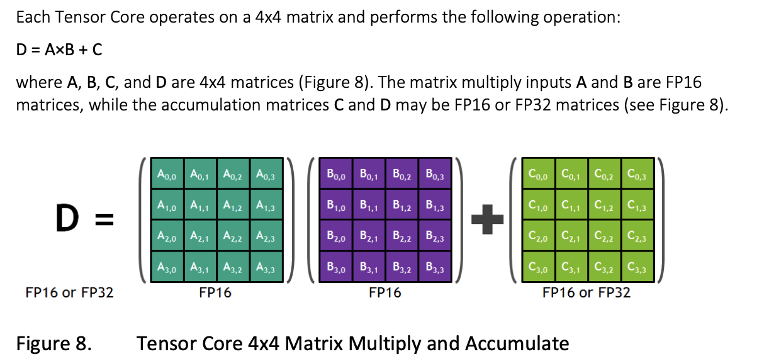
Tensor cores (1)
https://images.nvidia.com/content/volta-architecture/pdf/volta-architecture-whitepaper.pdf

Slide 6
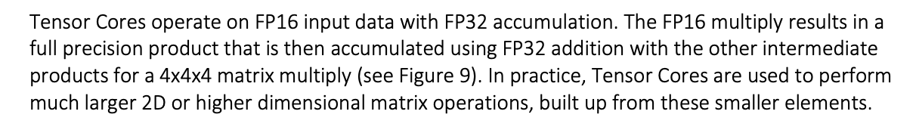
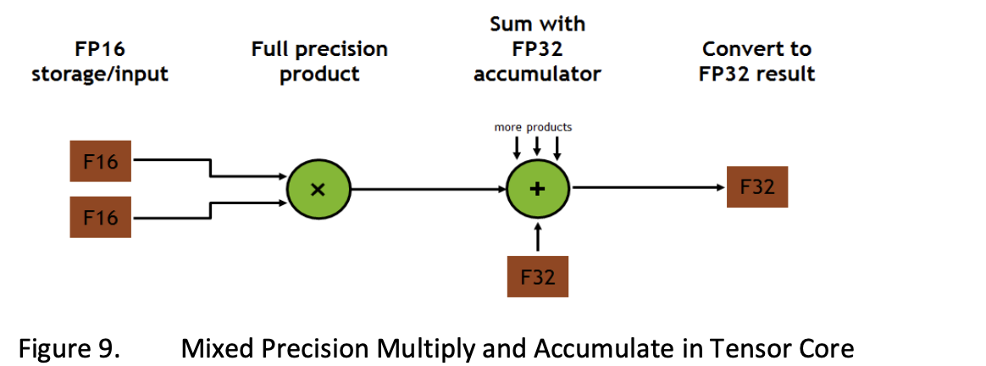
Tensor cores (2)
https://images.nvidia.com/content/volta-architecture/pdf/volta-architecture-whitepaper.pdf

Slide 7
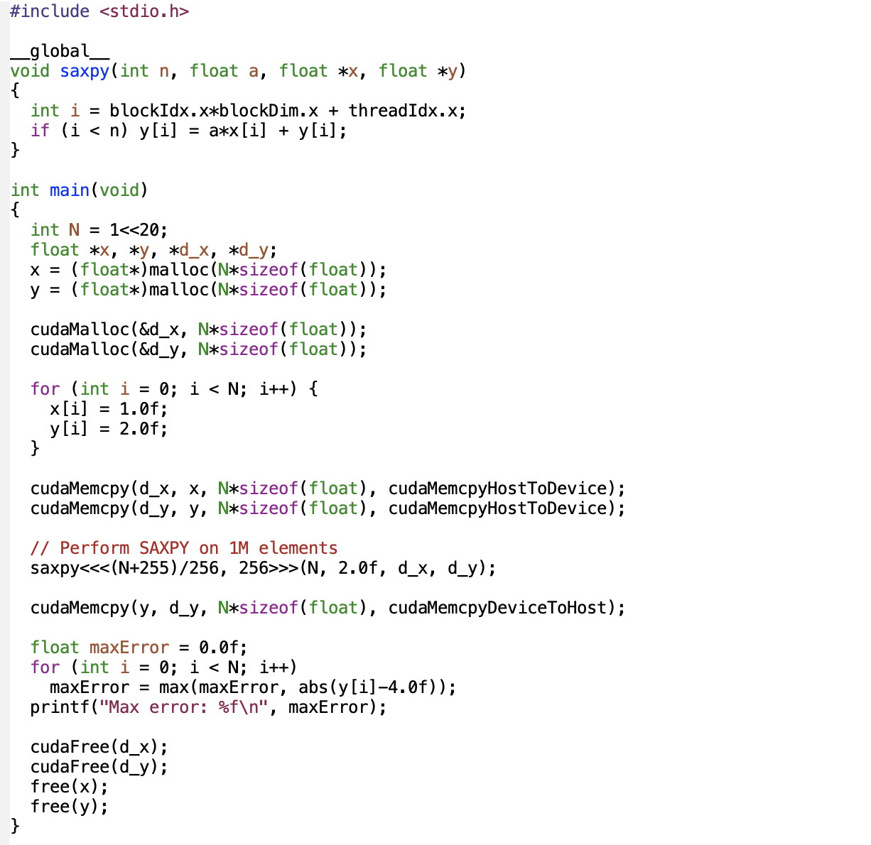
Another example
SAXPY stands for “Single-precision A*X Plus Y”
https://developer.nvidia.com/blog/easy-introduction-cuda-c-and-c

Slide 8
How to map a neural network on a GPU?

Slide 9
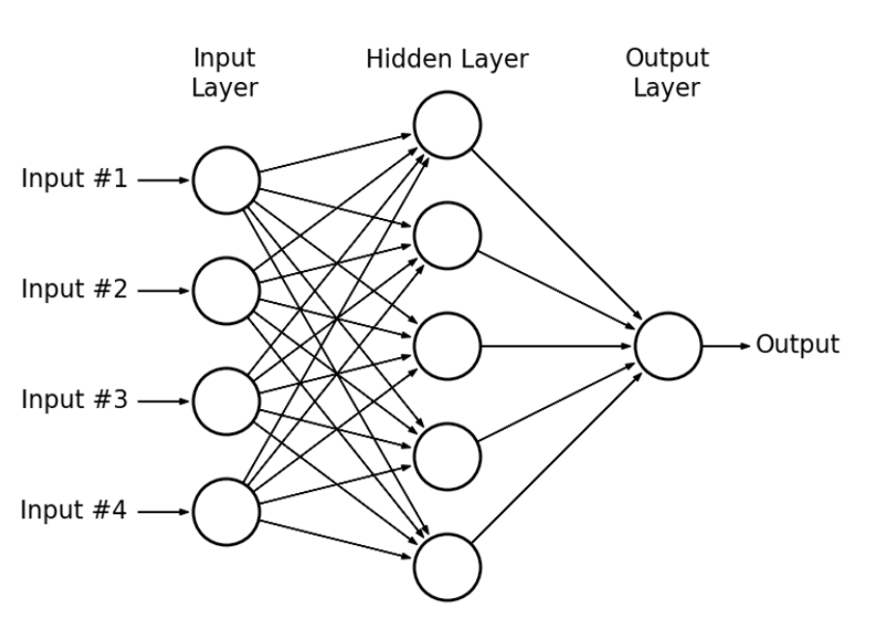
Multi-layer perceptron (MLP)
What parallelism can be exploited?

Slide 10

Multi-layer perceptron (MLP)
Data parallelism: You can process multiple training examples simultaneously. Since each example is processed independently through the forward pass, you can distribute batches across different computing units.
Model parallelism: The network itself can be partitioned, with different parts of the model assigned to different processors. This works particularly well for very large networks.
Layer-wise parallelism: Within each layer, the computations can be parallelized since neurons in the same layer operate independently.

Slide 11
Multi-layer perceptron (MLP)
Matrix multiplications: The core operation in MLPs (Wx + b) is highly parallelizable. Each output neuron's computation is independent.
Activation functions: These are applied element-wise and can be computed in parallel across all neurons.
Backpropagation: During training, gradient computations can be parallelized both within and across layers.

Slide 12
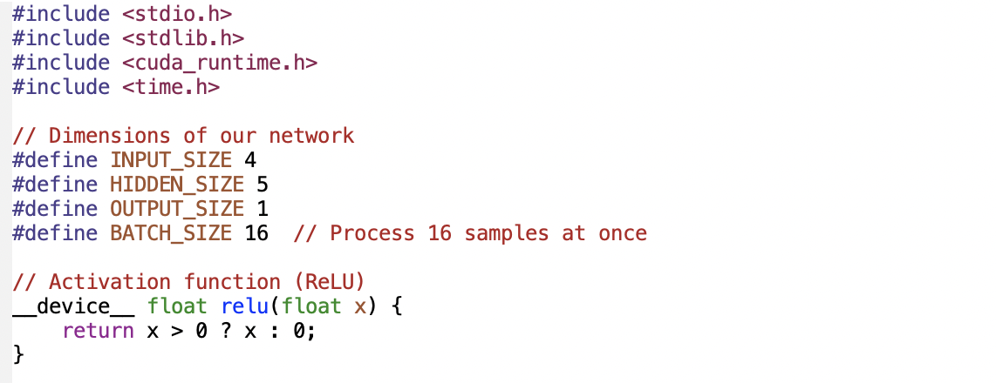
CUDA MLP (1)
…
16 batches

Slide 13
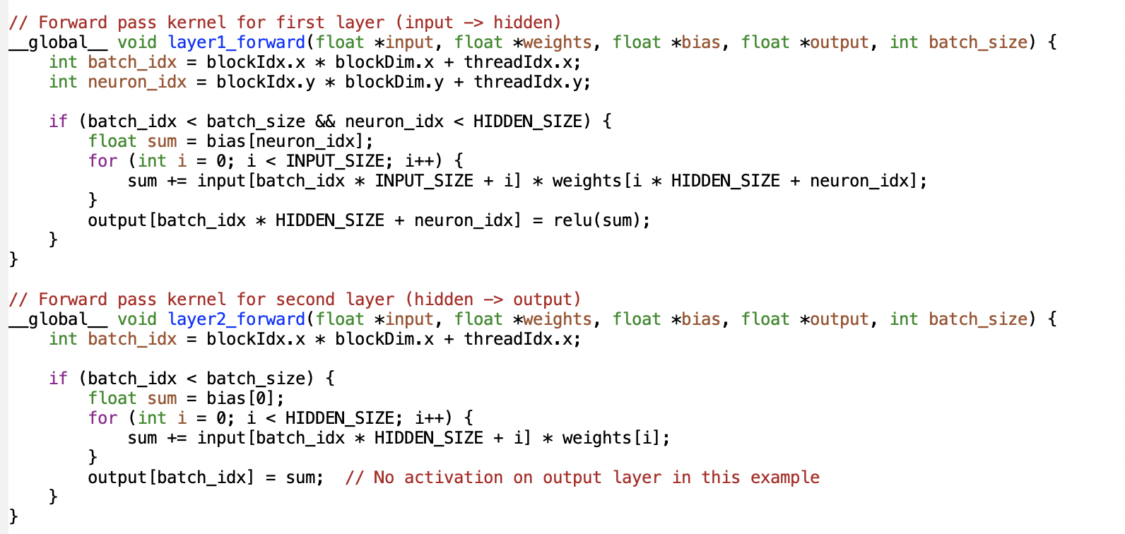
CUDA MLP (2)
Global thread ID (x coordinate)
Global y coordinate

Slide 14
CUDA MLP (3)
Why separate kernels for each layer?
Memory optimization: Each layer has different memory access patterns and working set sizes. Separate kernels allow you to optimize memory usage specifically for each layer's requirements rather than trying to find a one-size-fits-all approach.
Parallelism control: Different layers may benefit from different thread configurations. For example, the first layer in our implementation handles 4 inputs to 5 neurons, while the output layer handles 5 inputs to 1 neuron - these naturally map to different parallelization strategies.
Resource utilization: GPU resources like shared memory, registers, and thread counts can be tailored specifically to each layer's computational needs, which improves overall efficiency.
Kernel fusion limitations: While fusing operations into a single kernel can reduce launch overhead, there are practical limits to how much computation can be packed into one kernel before it becomes inefficient. Separate kernels help manage this complexity.
Synchronization points: Having distinct kernels creates natural synchronization points between layers, ensuring all computations from one layer are complete before the next layer begins processing.
Debugging and profiling: With separate kernels, it's easier to identify performance bottlenecks or errors in specific parts of the network.
Specialized optimizations: Different mathematical operations may benefit from specialized implementations - convolutions, fully-connected layers, and activation functions all have different optimal implementations on GPUs.

Slide 15
CUDA MLP (4)
How much should be in a kernel?
The optimal kernel size involves balancing several trade-offs:
Kernel launch overhead: Each kernel launch incurs some overhead. Too many small kernels can result in performance degradation due to this overhead.
Register pressure: Larger kernels with more operations typically require more registers per thread, which can reduce occupancy (the number of threads that can run simultaneously on the GPU).
Instruction cache: GPUs have limited instruction cache. Very large kernels might not fit well in the cache, causing additional latency.
Memory bandwidth utilization: Kernels that load data, perform a small operation, and then store results can be memory-bound. Combining multiple operations in one kernel can improve arithmetic intensity and make better use of compute resources.
Thread divergence: If your kernel contains many conditional branches that cause different threads to follow different execution paths, performance will suffer.
As a general guideline:
Good candidates for fusion: Operations that work on the same data and have similar parallelization patterns (like a matrix multiplication followed by an element-wise activation function).
Better kept separate: Operations with fundamentally different access patterns or parallelization strategies.

Slide 16
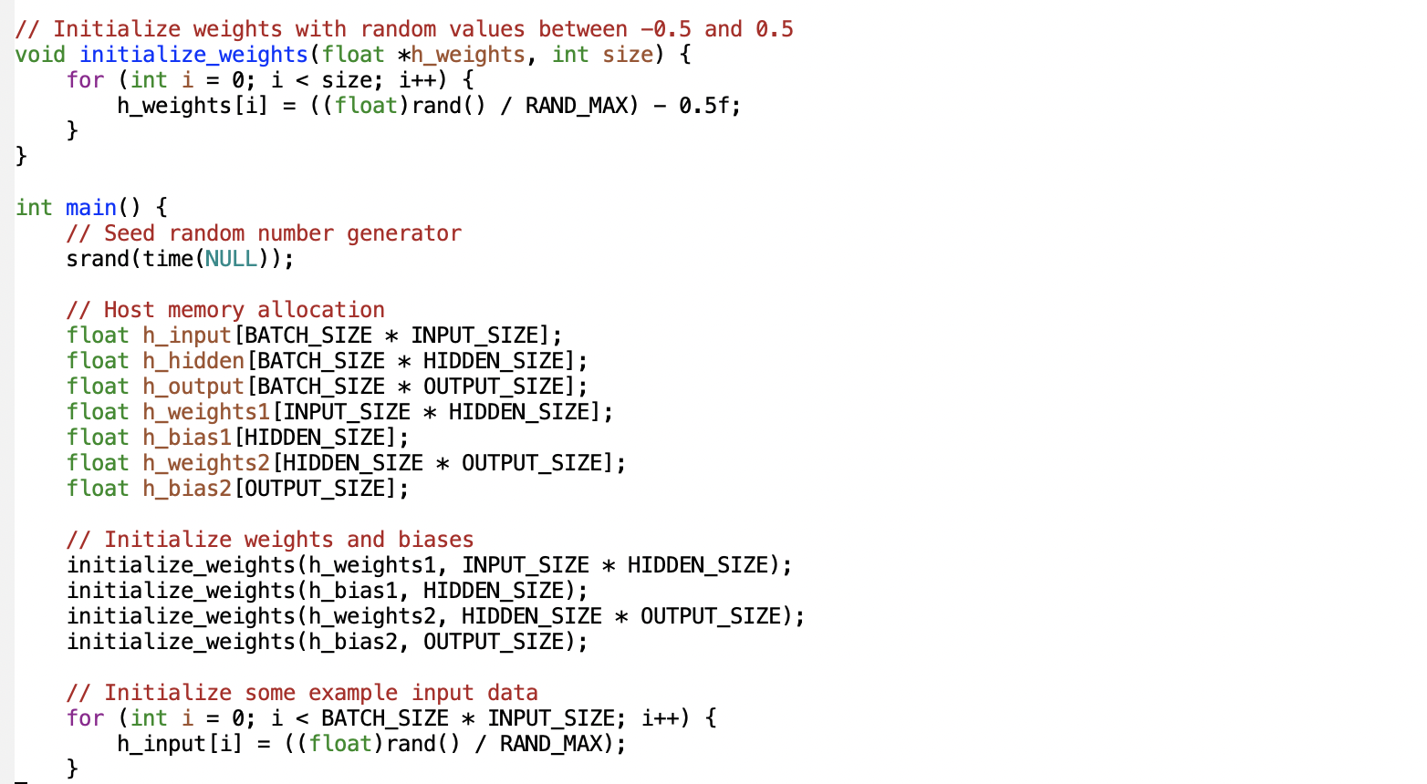
CUDA MLP (5)

Slide 17
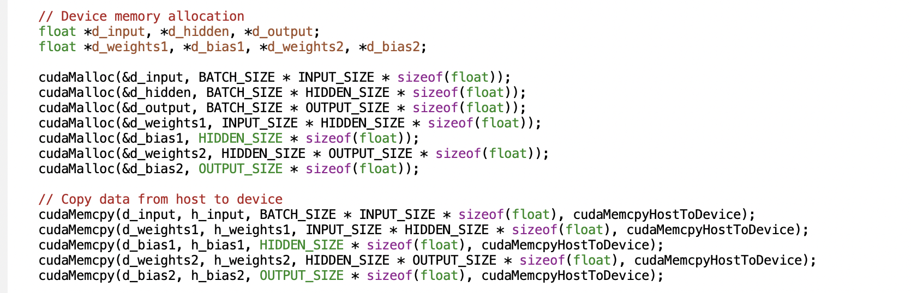
CUDA MLP (6)

Slide 18
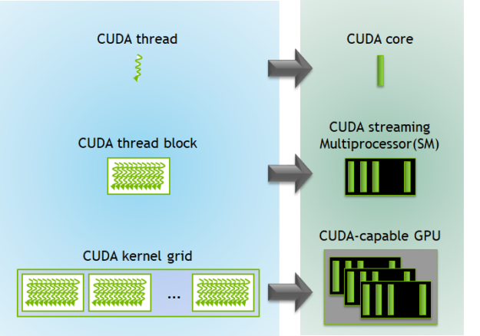
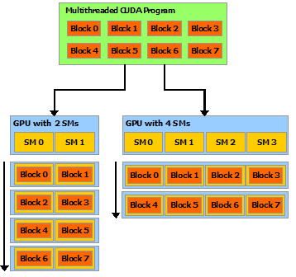
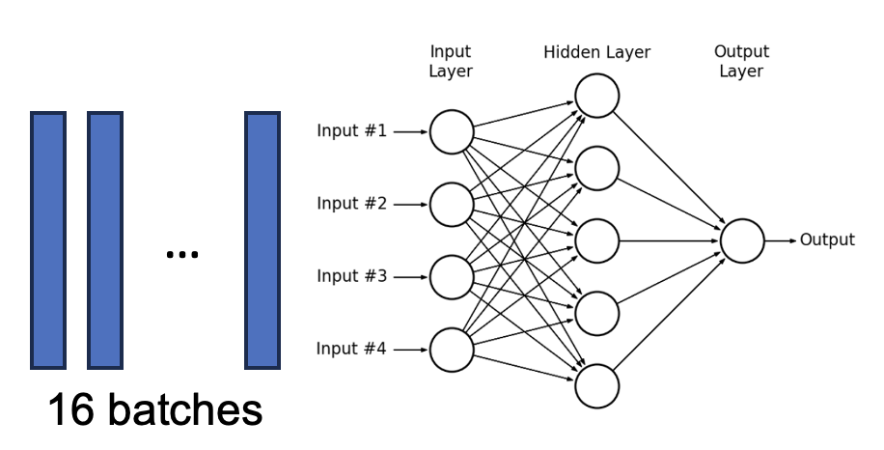
CUDA MLP (7)
How will we use threads for this MLP?
A GPU is built around an array of Streaming Multiprocessors (SMs). A multithreaded program is partitioned into blocks of threads that execute independently from each other.

Slide 19
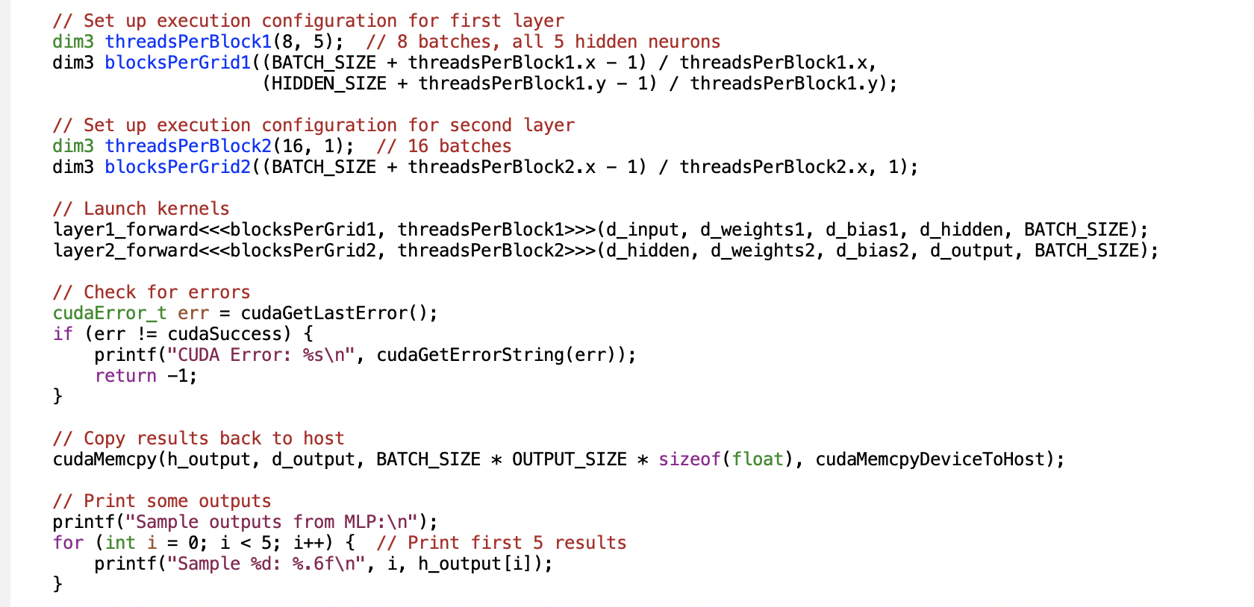
CUDA MLP (8)
Why?
kernel<<M,T>>
The kernel launches with a grid of M thread blocks. Each thread block has T parallel threads.
A GPU is built around an array of Streaming Multiprocessors (SMs). A multithreaded program is partitioned into blocks of threads that execute independently from each other.

Slide 20
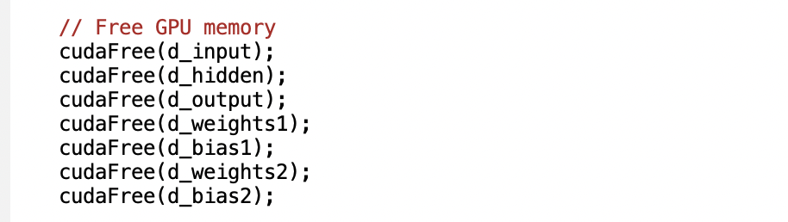
CUDA MLP (9)

Slide 21
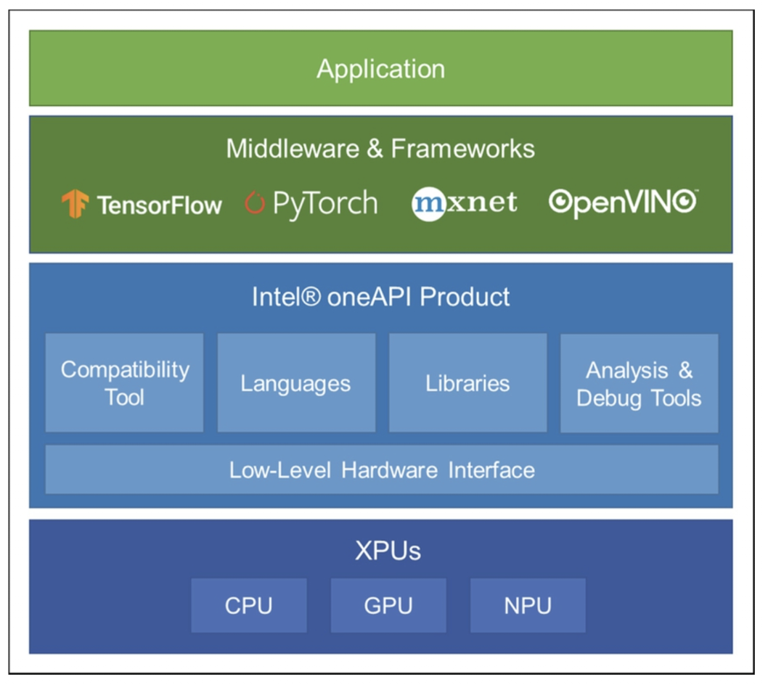

Deep learning frameworks
Deep learning frameworks provide interfaces to implement AI functionalities regardless of hardware or computing platforms.
Most deep learning frameworks also optimize the network in a hardware-friendly manner and utilize the hardware resources and acceleration functions as much as possible.
Because GPUs are commonly used in deep learning, deep learning frameworks widely support constructing and deploying neural networks on GPU and actively reflect the acceleration support from GPU vendors.
In addition, they provide optimizations on standalone accelerators such as TPU and specific environments such as cloud servers.
Mishra, Ashutosh; Cha, Jaekwang; Park, Hyunbin; Kim, Shiho. Artificial Intelligence and Hardware Accelerators, 2025

Slide 22
PyTorch & CNNs
For CNNs, the mapping process involves:
Tensor operations: PyTorch represents all data (images, weights, activations) as tensors that can be moved between CPU and GPU memory.
Layer-by-layer optimization: Each CNN layer (convolution, pooling, etc.) is mapped to specific GPU kernels that efficiently perform the required operations in parallel.
Memory management: PyTorch handles the complex memory allocations and transfers between host (CPU) and device (GPU) memory.
Computation graphs: PyTorch builds a dynamic computation graph that tracks operations and enables automatic differentiation for training.
Batching: Multiple inputs are processed simultaneously to maximize GPU utilization.
For the convolution operations specifically, PyTorch typically uses highly optimized libraries like cuDNN that implement various algorithms (direct convolution, FFT-based, Winograd, etc.) and automatically select the most efficient one based on input size and available GPU resources.

Slide 23
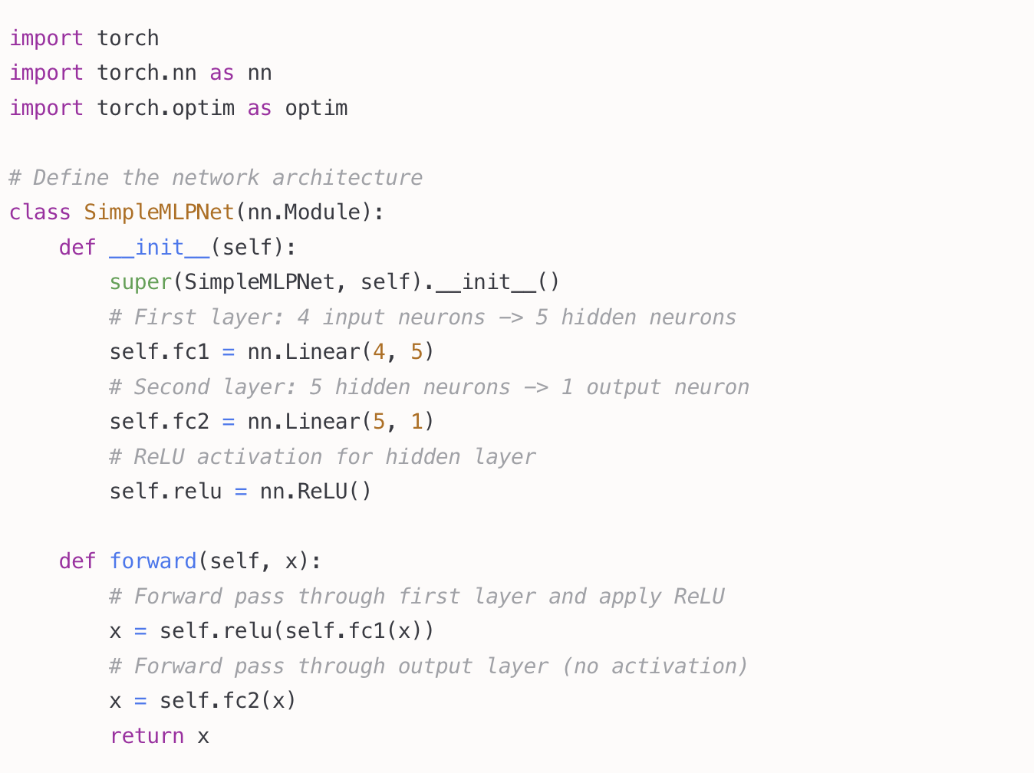
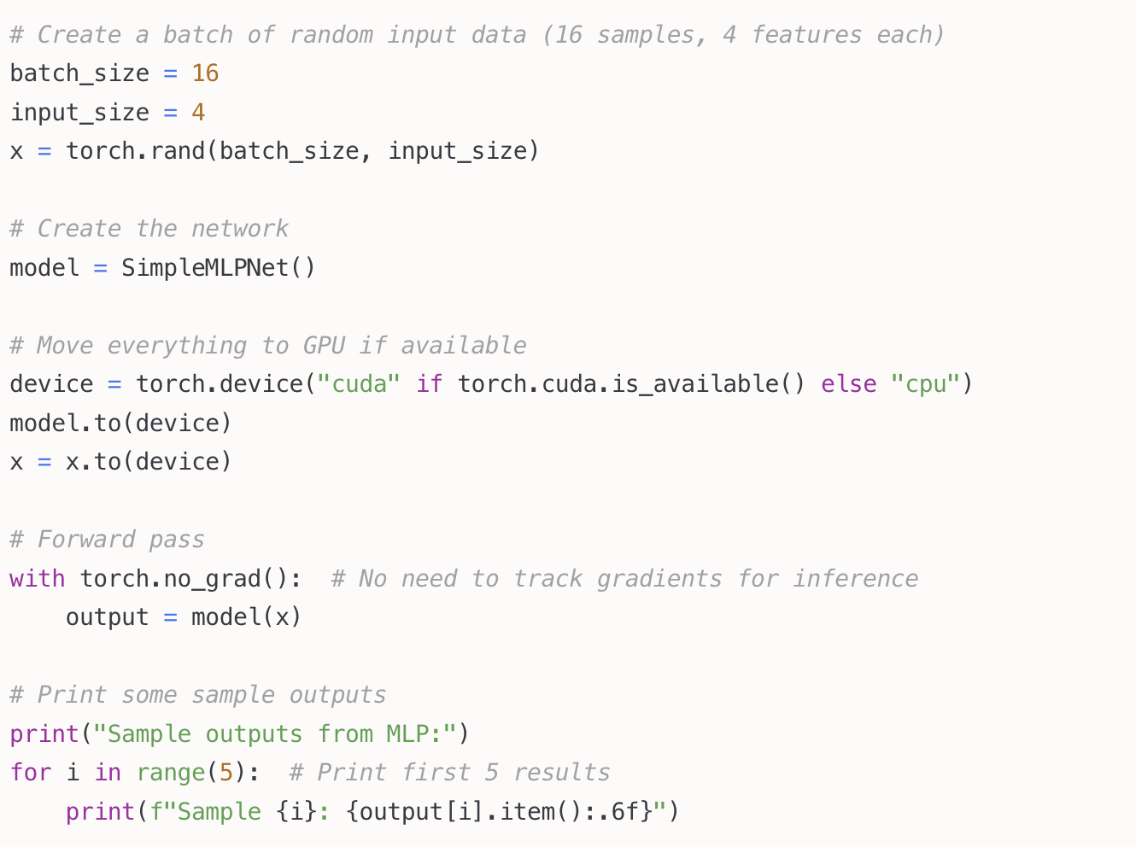
PyTorch

Slide 24
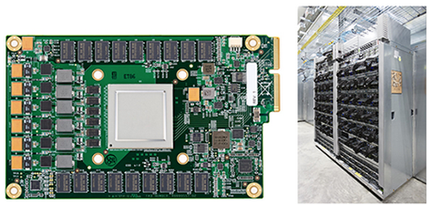
GPU vs Tensor Processing Unit (TPU)

Slide 25
GPU vs TPU
 | GPU | TPU
Origin and design purpose | Graphics | Created by Google for ML
Architecture | Thousands of smaller cores designed for parallel processing. | More specialized architecture with matrix processing units (MXUs) specifically optimized for tensor operations.
Performance focus | More flexibility, broader applicability | Optimized for matrix operations and ML workloads.
Development and availability | NVIDIA, AMD, etc. | Proprietary, only through Google cloud
Software compatibility | Various frameworks, e.g., CUDA | TensorFlow
Power efficiency | Less power-efficient, but more flexibility | More power-efficient

Slide 26
TPU key features
Matrix Multiplication Unit (MXU): The central component designed to perform matrix operations quickly. It loads parameters and data from high-bandwidth memory (HBM), executes multiplications, and passes results to the next multiply-accumulator.
TensorCores: Each TPU chip contains one or more TensorCores, with the number depending on the version. Each TensorCore consists of one or more matrix-multiply units, a vector unit, and a scalar unit.
Activation Unit (AU): Provides hardwired activation functions commonly used in neural networks

Slide 27
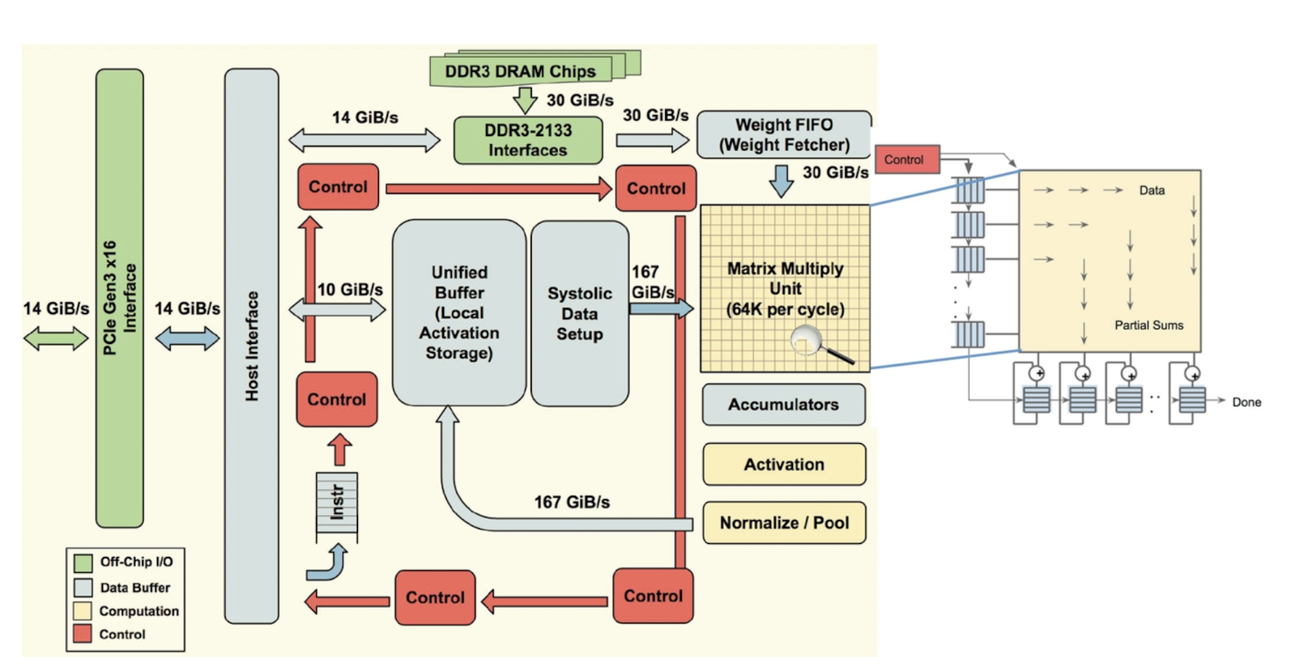
Architecture of a TPU accelerator
The main component of TPU is the MXU that consists of 256 by 256 (i.e., 65,536) MACs to perform 8-bit mathematical operations.
The MXU gets its input from the weighted FIFO and unified buffer (UB).
https://cloud.google.com/blog/products/ai-machine-learning/an-in-depth-look-at-googles-first-tensor-processing-unit-tpu

Slide 28
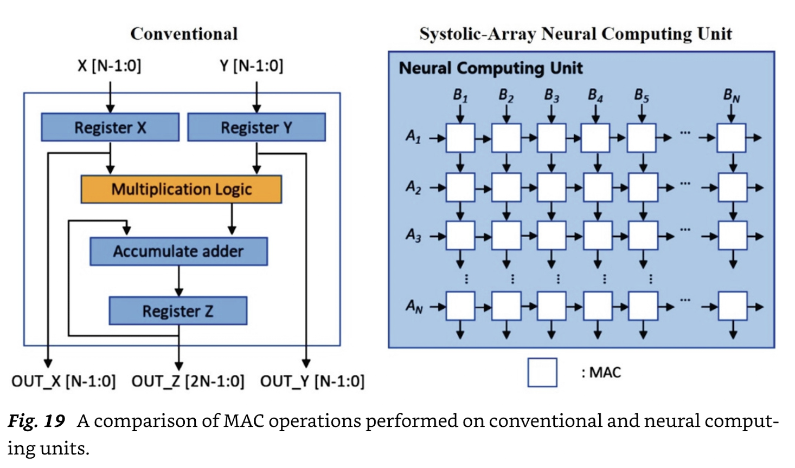
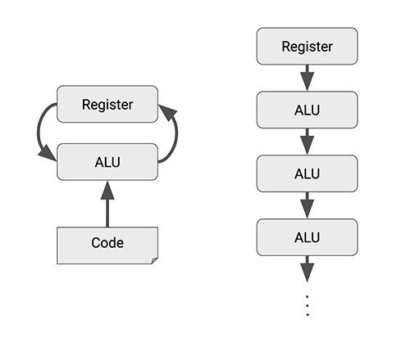
Systolic array (1)
The name "systolic" comes from an analogy to the human heart, where data pulses through the array of processors in a rhythmic, synchronized fashion.
CPUs and GPUs often spend energy to access multiple registers per operation. A systolic array chains multiple ALUs together, reusing the result of reading a single register.
Mishra et al., 2023

Slide 29
Systolic array (2)
Systolic arrays, are characterized by:
Pre-defined computational flow graph that connects their nodes.
Regular arrangement of (simple) processing elements (PEs) in a grid pattern.
Data flows rhythmically through the array of processors.
Each PE performs the same operation (typically multiply-accumulate).
Processing elements operate in lockstep, controlled by a global clock signal. [Wavefront computers, on the other hand, are asynchronous and data-driven.]
In a systolic array, all processing elements execute the same instruction (or fixed function) at any given time, just on different data values.
MISD or SIMD or ? Controversial…

Slide 30
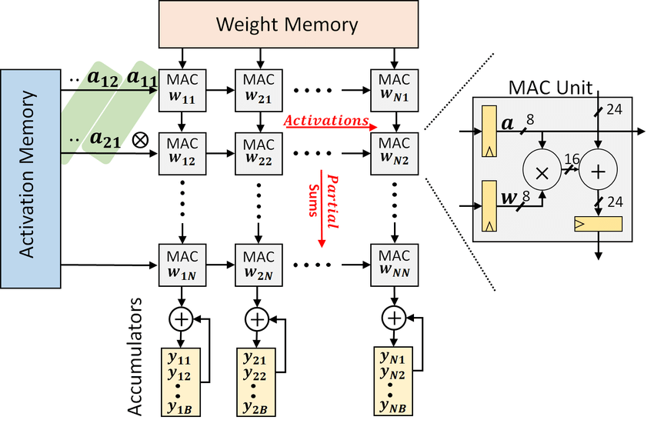
How to map a deep neural net on a systolic array
https://doi.org/10.1145/3195970.3196129

Slide 31
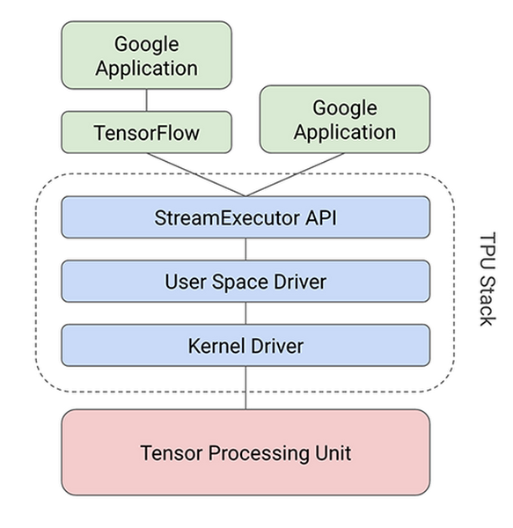
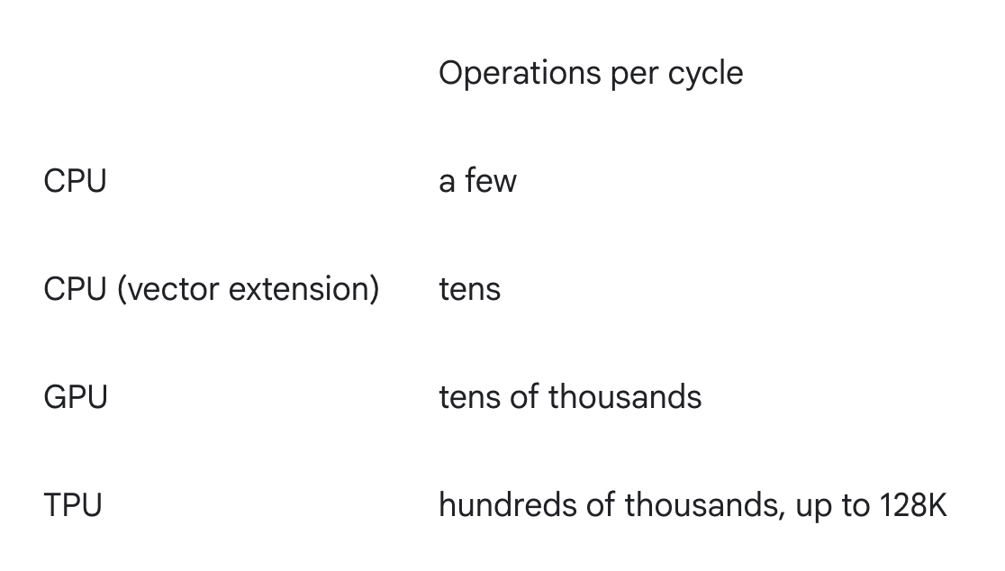
Google’s TPU
https://cloud.google.com/tpu/docs/system-architecture-tpu-vm

Slide 32
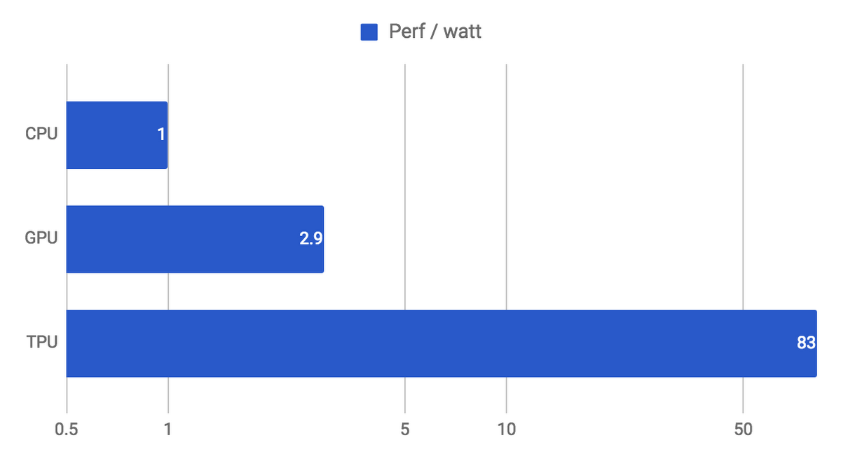
Google’s TPU
https://cloud.google.com/tpu/docs/system-architecture-tpu-vm

Slide 33
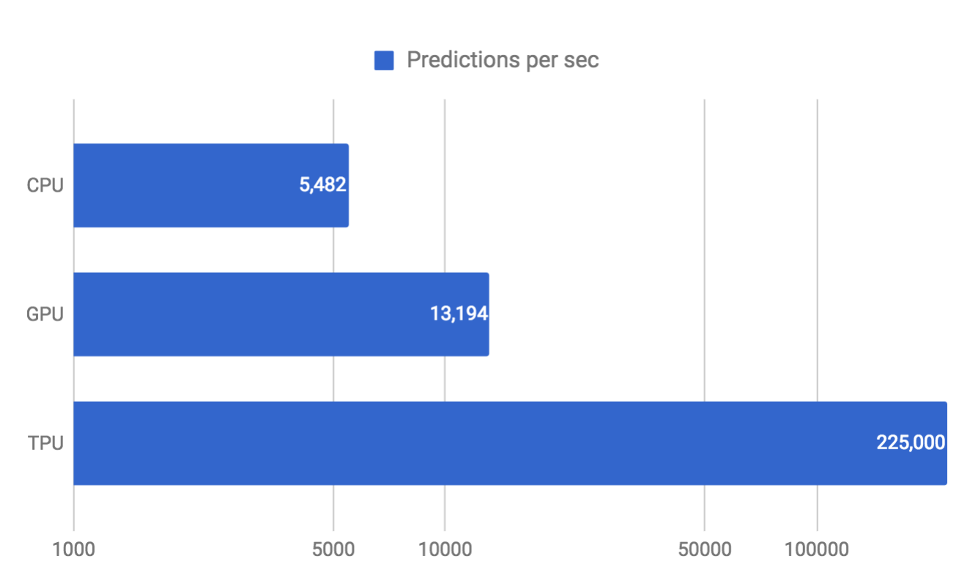
Google’s TPU
https://cloud.google.com/tpu/docs/system-architecture-tpu-vm

Slide 34
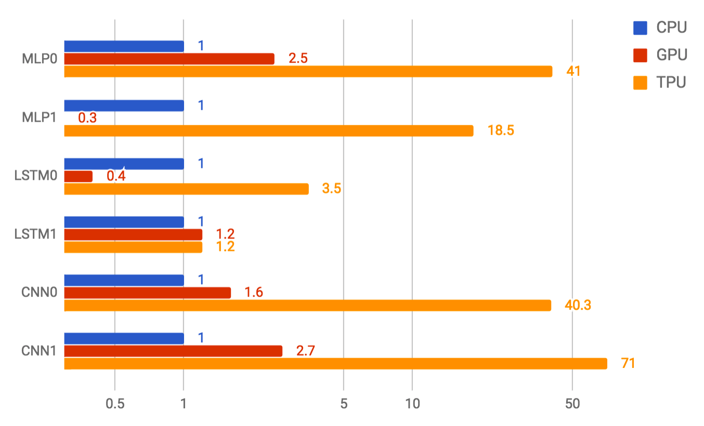
Google’s TPU
https://cloud.google.com/tpu/docs/system-architecture-tpu-vm

Slide 35
Transformers

Slide 36

2017 landmark paper
https://arxiv.org/pdf/1706.03762

Slide 37

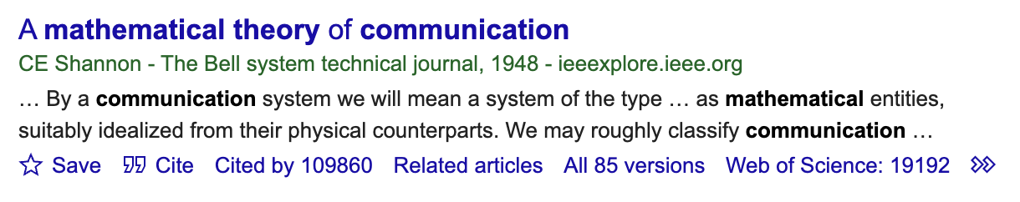
2017 landmark paper
https://arxiv.org/pdf/1706.03762

Slide 38
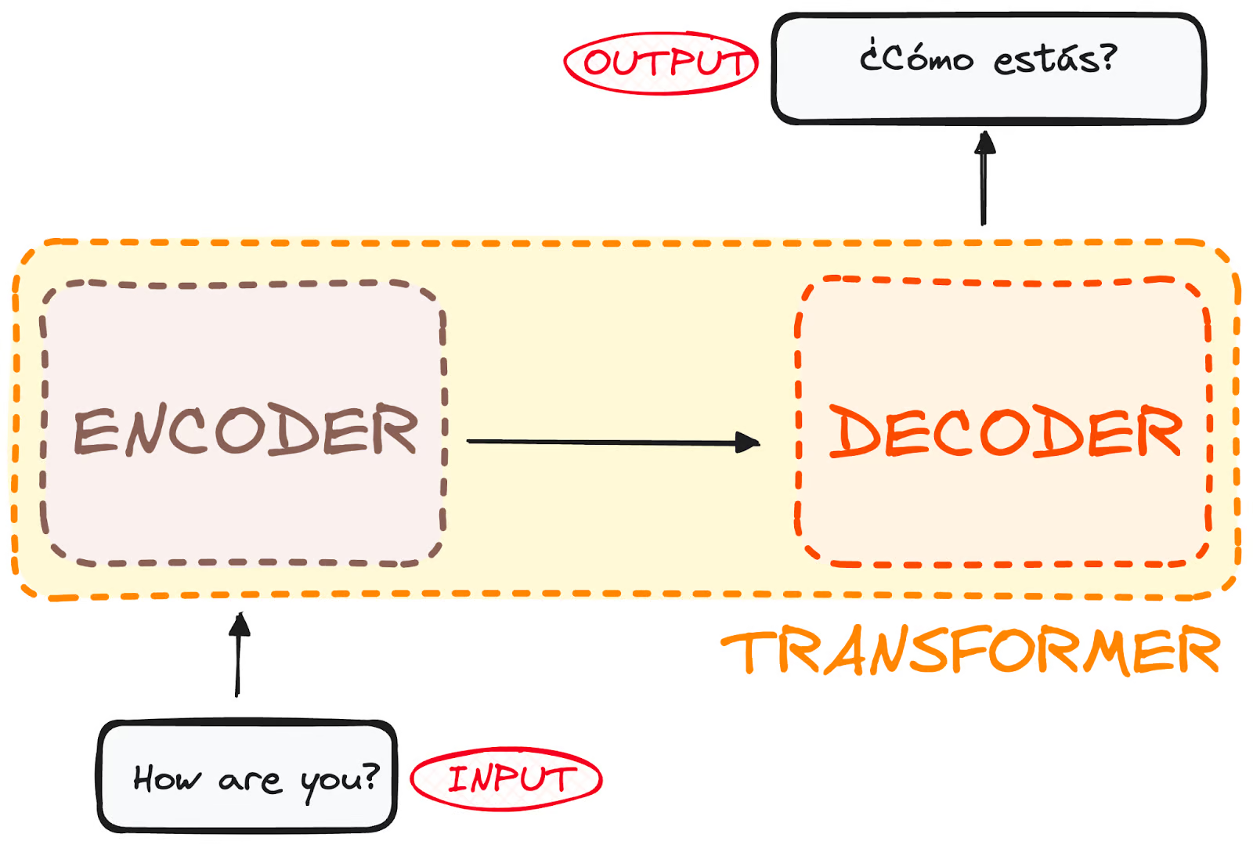
What is a transformer?
A transformer is designed to comprehend context and meaning by analyzing the relationship between different elements.
The model is primarily composed of two blocks:
Encoder (left): The encoder receives an input and builds a representation of it (its features). This means that the model is optimized to acquire understanding from the input.
Decoder (right): The decoder uses the encoder’s representation (features) along with other inputs to generate a target sequence. This means that the model is optimized for generating outputs.
https://huggingface.co/learn/llm-course/en/chapter1/4
https://www.datacamp.com/tutorial/how-transformers-work

Slide 39
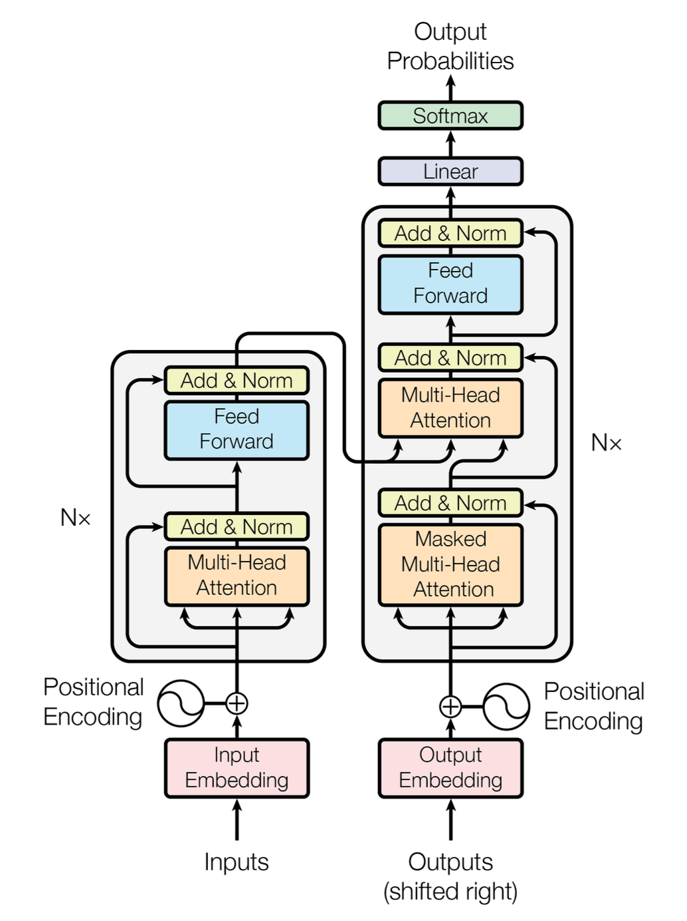
What is a transformer?
“A transformer model is a neural network that learns context and thus meaning by tracking relationships in sequential data like the words in this sentence.”
Transformers made self-supervised learning possible.
“Transformer models apply an evolving set of mathematical techniques, called attention or self-attention, to detect subtle ways even distant data elements in a series influence and depend on each other.”
https://arxiv.org/pdf/1706.03762
Encoder
Decoder

Slide 40
What is a transformer?
Addresses all drawbacks of recurrent neural nets (RNN)
No labels (costly and time-consuming)
Very parallelizable
Higher performance
Like most neural networks, transformer models are basically large encoder/decoder (compression/decompression) blocks that process data.
Transformers use positional encoders to tag data elements coming in and out of the network.
Attention units follow these tags, calculating a kind of algebraic map of how each element relates to the others.
Attention queries are typically executed in parallel by calculating a matrix of equations in what’s called multi-headed attention.
https://arxiv.org/pdf/1706.03762
https://blogs.nvidia.com/blog/what-is-a-transformer-model

Slide 41
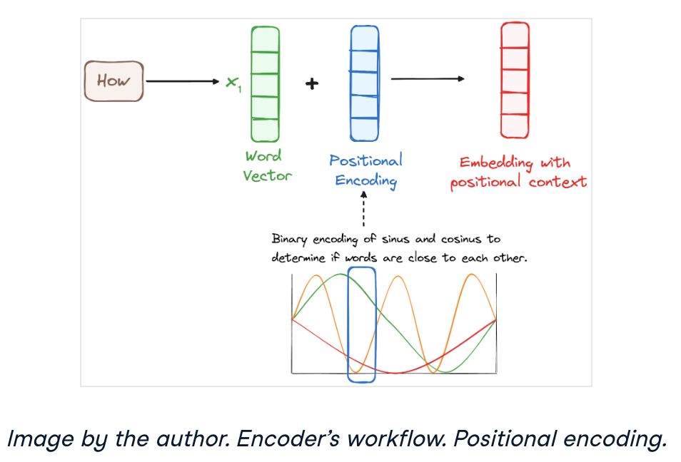
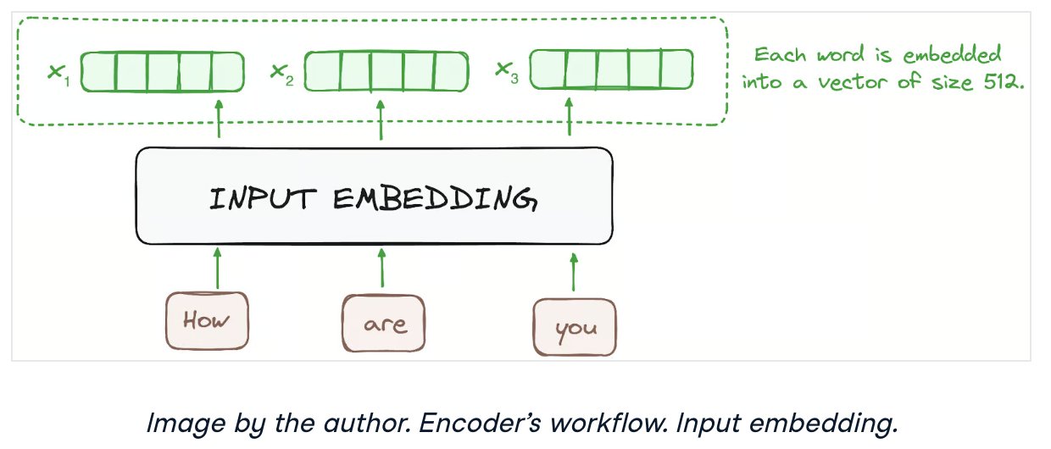
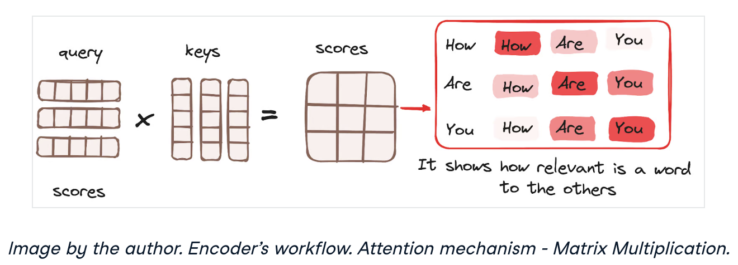
What is a transformer?
A transformer is designed to comprehend context and meaning by analyzing the relationship between different elements.
https://www.datacamp.com/tutorial/how-transformers-work

Slide 42
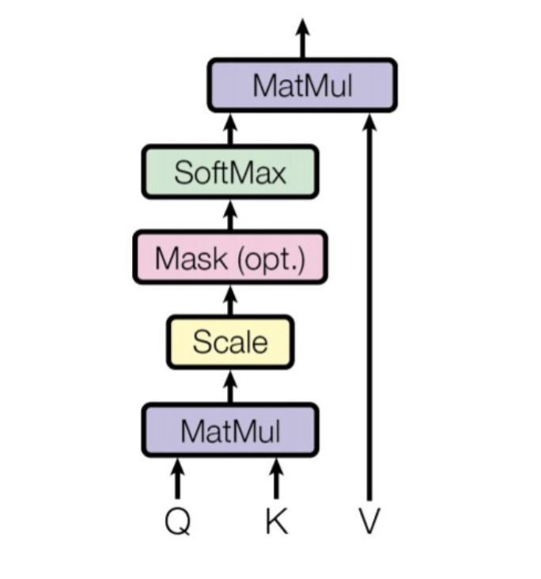
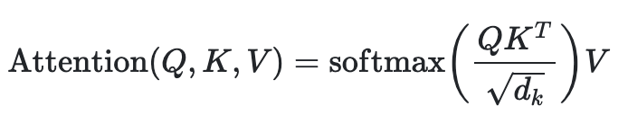
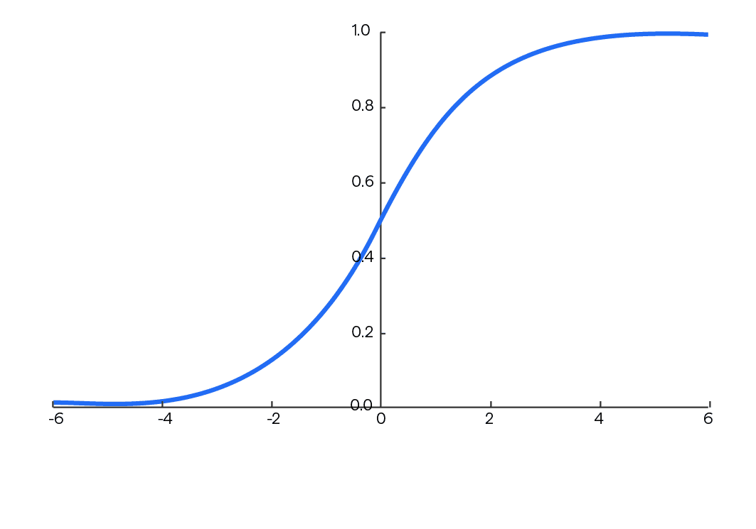
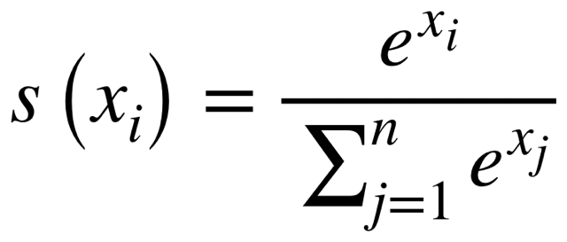
Main mathematical operations of a transformer
Matrix Multiplication - Used throughout the architecture, particularly in the attention mechanism and feed-forward networks.
Attention Mechanism - The core operation involving:
Query, Key, Value transformations (matrix multiplications)
Scaled dot-product attention:
Multi-head attention which runs multiple attention operations in parallel
Layer Normalization - Normalizes the outputs of sub-layers using mean and variance statistics
Residual Connections (Skip Connections) - Addition operations that help with gradient flow
Position-wise Feed-Forward Networks - Two linear transformations with a ReLU activation in between
Softmax - Used in the attention mechanism to convert scores to probabilities
Positional Encoding - Often implemented using sine and cosine functions of different frequencies [GPU SFU]
Embedding - Converting tokens to continuous vector representations
[GPU SFU]
Query Key Value

Slide 43
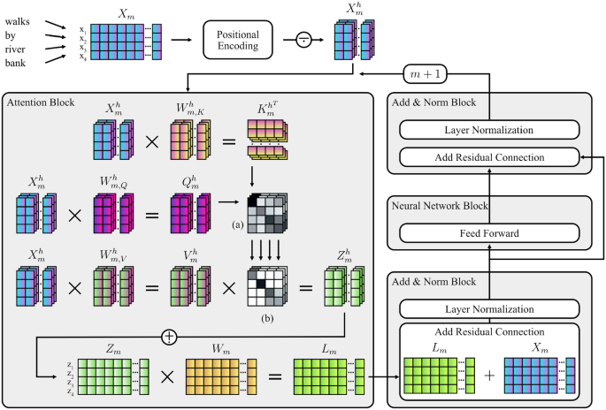
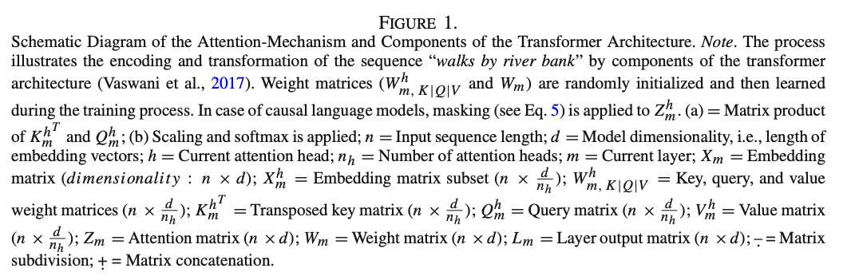
How to map transformers on a GPU
Hommel, B.E., Wollang, FJ.M., Kotova, V. et al. Transformer-Based Deep Neural Language Modeling for Construct-Specific Automatic Item Generation. Psychometrika 87, 749–772 (2022). https://doi.org/10.1007/s11336-021-09823-9

Slide 44
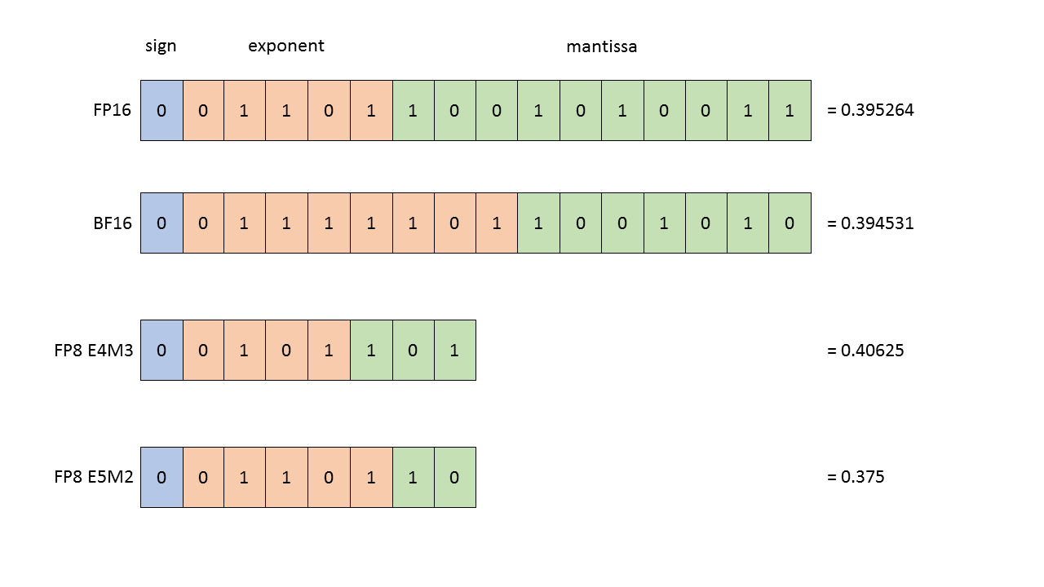
Reducing precision
FP8 is an 8-bit floating point standard which was jointly developed by NVIDIA, ARM, and Intel to speed up AI development by improving memory efficiency during AI training and inference processes.
The ongoing industry evolution is evident in the shift from 32-bit to 16-bit, and currently, to 8-bit precision formats. This change is especially advantageous for transformer networks, crucial AI breakthroughs, as they perform better with the detailed precision provided by 8-bit floating point formats.
The E5M2 format adapts the IEEE FP16 format, allocating five bits to the exponent and two bits to the mantissa. The E4M3 format assigns four bits for the exponent and three bits for the mantissa with slight adjustments. These two eight-bit configurations are designed to optimize both training and inference phases, promising to cut down computational loads in comparison to their more precise counterparts.
The FP8 standard preserves accuracy comparable to 16-bit formats across a wide range of applications, architectures, and networks.
https://docs.nvidia.com/deeplearning/transformer-engine/user-guide/examples/fp8_primer.html
https://docs.nvidia.com/deeplearning/transformer-engine/user-guide/index.html
https://www.nvidia.com/en-us/data-center/technologies/blackwell-architecture

Slide 45
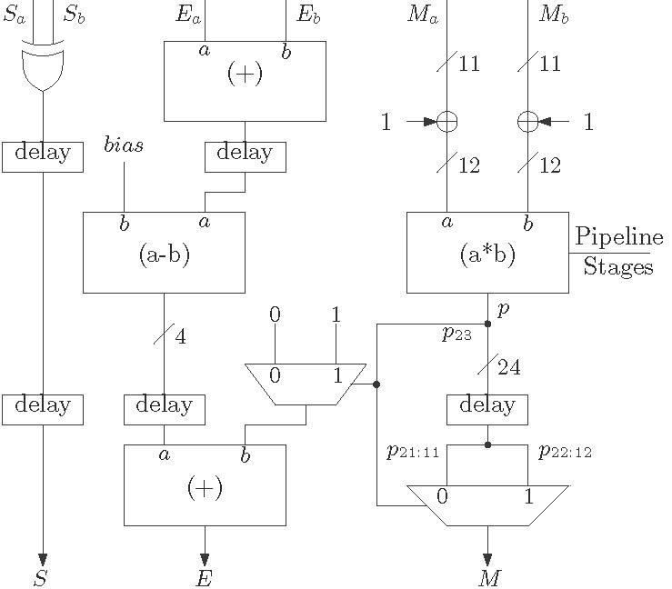
Why is FP8 faster than FP16?
Data Transfer Efficiency: Since FP8 values are half the size of FP16 values, one can move twice as much data in the same memory bandwidth. Memory bandwidth is often a bottleneck in computations, so this alone can provide significant speedups.
Cache Efficiency: Smaller data types mean more values can fit in cache, reducing expensive off-chip memory accesses.
Compute Density: One can fit more FP8 arithmetic units in the same silicon area compared to FP16 units. This means more parallel operations can be performed simultaneously.
Power Efficiency: Lower precision operations consume less power, allowing for higher clock speeds or more operations within the same power envelope.

Slide 46
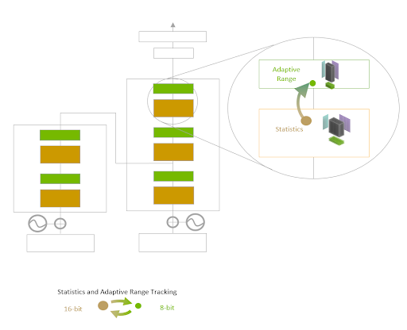

NVIDIA Transformer Engine (1st gen)
Essentially a library that uses the the GPU tensor cores.
Transformer Engine uses per-layer statistical analysis to dynamically determine the optimal precision (FP16 or FP8) for each layer of a model, achieving the best performance while preserving model accuracy.
https://www.hardwarezone.com.sg/tech-news-nvidia-h100-gpu-hopper-architecture-building-block-ai-infrastructure-dgx-h100-supercomputer
https://blogs.nvidia.com/blog/h100-transformer-engine
https://docs.nvidia.com/deeplearning/transformer-engine/user-guide/index.html
https://www.nvidia.com/en-us/data-center/technologies/blackwell-architecture

Slide 47

NVIDIA Blackwell Transformer Engine
https://blogs.nvidia.com/blog/h100-transformer-engine
https://docs.nvidia.com/deeplearning/transformer-engine/user-guide/index.html
https://www.nvidia.com/en-us/data-center/technologies/blackwell-architecture

Slide 48

https://ieeexplore.ieee.org/abstract/document/10962199

Slide 49
What transformer operations could we improve?
Matrix Multiplication - Used throughout the architecture, particularly in the attention mechanism and feed-forward networks.
Attention Mechanism - The core operation involving:
Query, Key, Value transformations (matrix multiplications)
Scaled dot-product attention:
Multi-head attention which runs multiple attention operations in parallel
Layer Normalization - Normalizes the outputs of sub-layers using mean and variance statistics
Residual Connections (Skip Connections) - Addition operations that help with gradient flow
Position-wise Feed-Forward Networks - Two linear transformations with a ReLU activation in between
Softmax - Used in the attention mechanism to convert scores to probabilities
Positional Encoding - Often implemented using sine and cosine functions of different frequencies
Embedding - Converting tokens to continuous vector representations
Query Key Value

Slide 50

Neuromorphic self-attention mechanism
https://ieeexplore.ieee.org/abstract/document/10962199

Slide 51

To spike or not to spike
Spiking neural networks are more energy efficient than traditional artificial neural networks primarily because:
Event-driven processing: SNNs only process information when neurons fire, unlike traditional ANNs which compute at every time step regardless of input changes. This significantly reduces power consumption.
Binary communication: SNNs communicate using discrete spikes (binary events) rather than continuous values, requiring less data transfer and simpler hardware.
Temporal encoding: Information in SNNs can be encoded in the timing of spikes, allowing for more efficient data representation compared to the amplitude-based encoding in ANNs.
Reduced precision requirements: SNNs can work with lower precision hardware since they use binary spikes, while ANNs typically need higher precision for gradient calculations.
Closer to biological efficiency: The human brain, which uses spiking neurons, consumes only about 20 watts while performing complex tasks that would require orders of magnitude more power on traditional computing hardware.

Slide 52

https://www.nature.com/articles/s41467-024-47811-6

Slide 53
Neuromorphic self-attention mechanism
AAC =
AND accumulate

Slide 54
AND accumulate
Traditional:
output = (input1 × weight1) + (input2 × weight2) + ... + (inputN × weightN)
AND accumulate:
output = (input1 AND weight1) + (input2 AND weight2) + ... + (inputN AND weightN)
This process essentially counts how many input-weight pairs are both "on" (1) at the same time, which serves as an approximation of multiplication in binary or highly quantized networks.

Slide 55


Dataflow of transposition calculation
https://ieeexplore.ieee.org/abstract/document/10962199

Slide 56

Resource overhead
Res. = Residuals
MP = membrane potential
https://ieeexplore.ieee.org/abstract/document/10962199

Slide 57

Comparison with state-of-the-art
https://ieeexplore.ieee.org/abstract/document/10962199

Slide 58

General AI accelerator architectures of FPGA and ASIC
Mishra, Ashutosh; Cha, Jaekwang; Park, Hyunbin; Kim, Shiho. Artificial Intelligence and Hardware Accelerators, 2025

Slide 59

DSP comparison
https://www.synopsys.com/blogs/chip-design/arc-vpx6-digital-signal-processor.html

Slide 60

Hardware for AI/ML
Mishra et al., 2023

